Slide 1
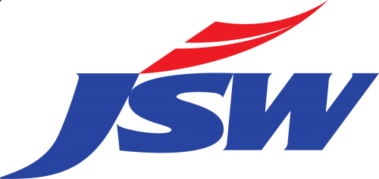
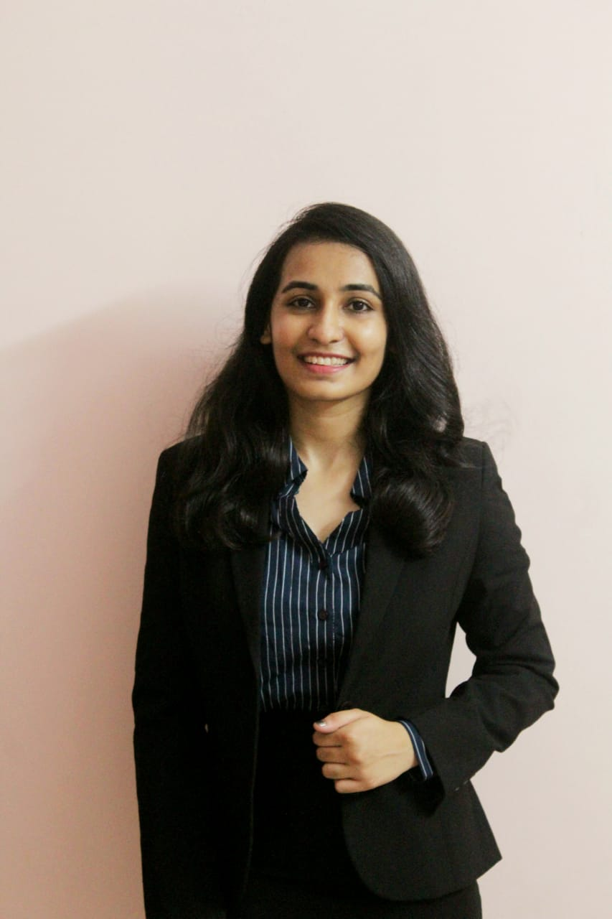
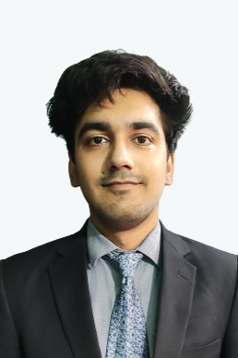
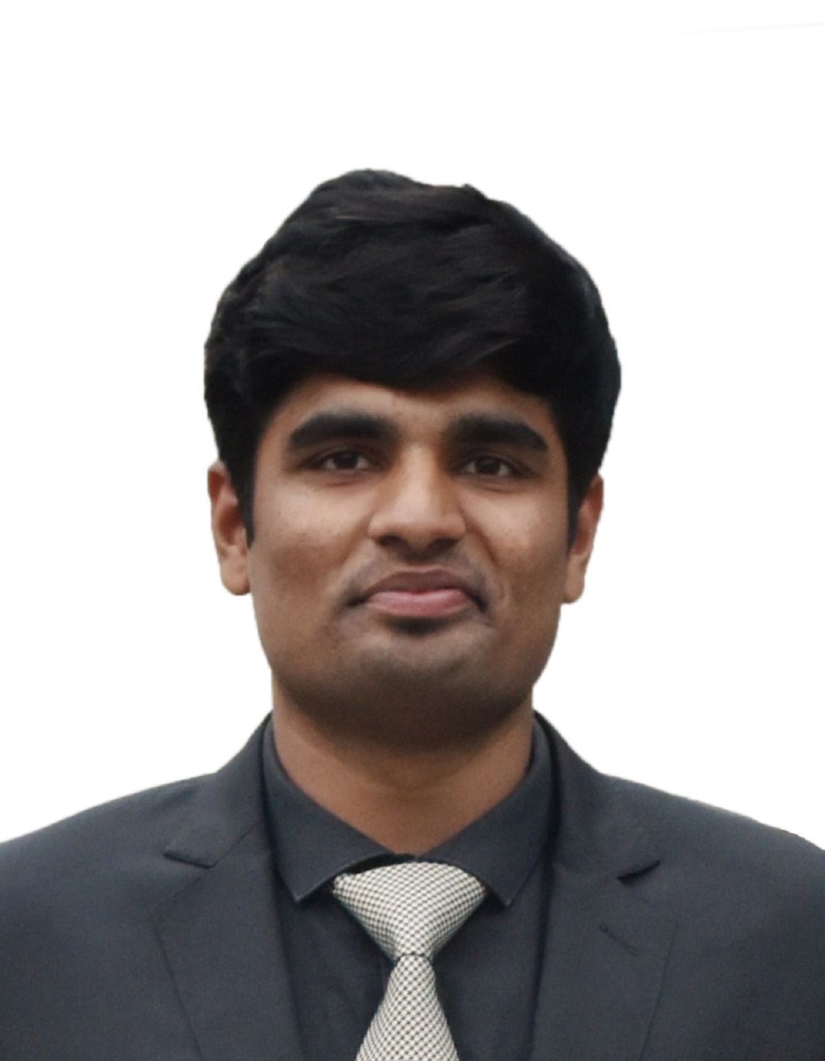
The
Challenge
2021
Round 2
Team PAOer | IIM Shillong
Priya Jain Akshay Kalsi Ojasvi Agrawal

Slide 2

Industry Overview
Competitive Matrix & Brand Leveraging
Strategy for Brand Penetration
Market Trends & Perceptual Mapping
Research and Segmentation
Increase in Segment Size

Slide 3


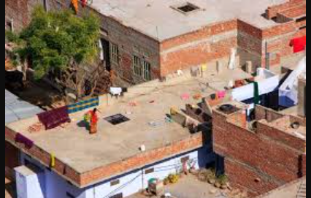
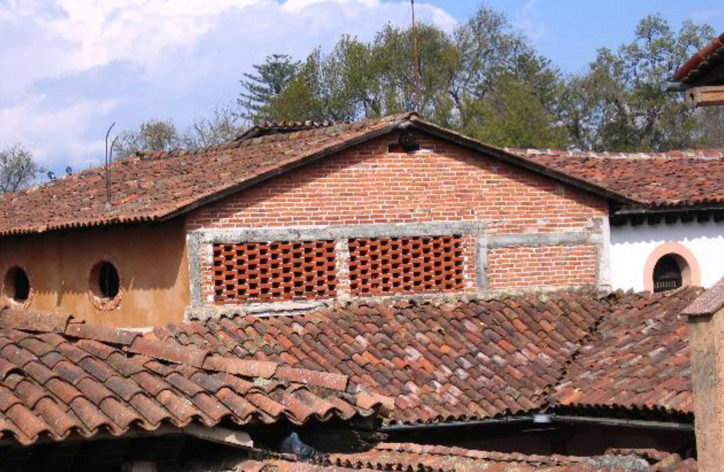
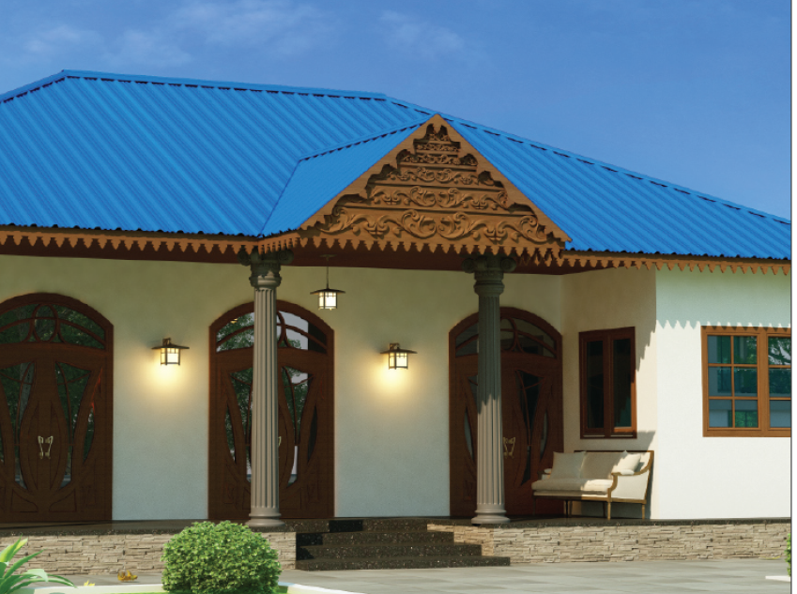

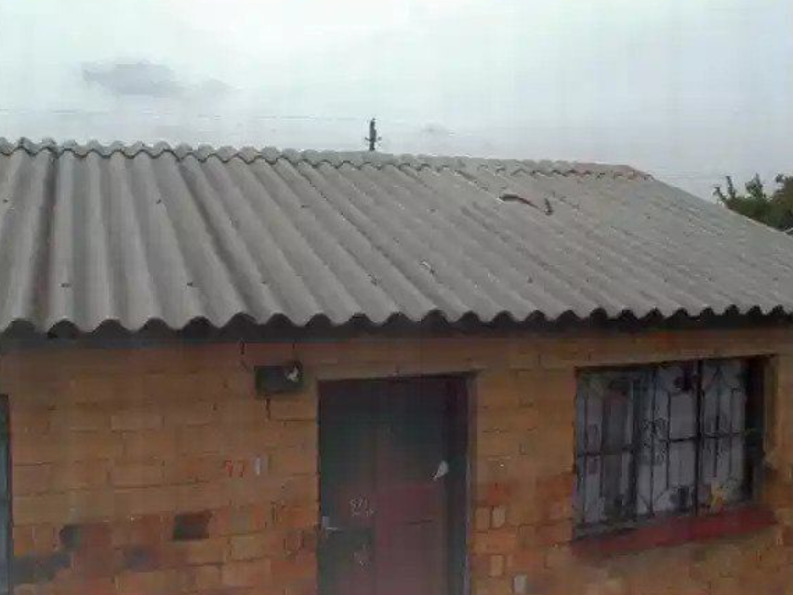
Industry Overview
Competitive Matrix & Brand Leveraging
Strategy for Brand Penetration
Market Trends & Perceptual Mapping
Research and Segmentation
Increase in Segment Size
Market Trends
Perceptual Mapping
Industry Growth
Innovation
High Price
RCC
The technological advancements and the introduction of new roofing technologies are likely to be the major factors driving the roofing market growth in India.
Clay Tiles
Anticipated growth of 7% in the forecast period of 2022-26.
CC/GC Sheets
Major developments in Galvanized Steel Sheets to Zn-Al coated. These advancements provides various advantages such as longevity, thermal insulation and energy conservation, and offering an aesthetically pleasing landscape
Low Quality
High Quality
Increasing Investment
Asbestos Sheets
Different roofing materials have been categorized based on the Price and Quality factors while considering the features expected by the customers.
Recent investments by the government and the international institutions like New Development Bank, Asian Development Bank, World Bank will help in boosting the infrastructure sector.
Meanwhile, the easy installation of roofing components and upgradation of previous infrastructure owing to the presence of advanced machinery is likely to be a key trend in the market.
Low Price
Thriving urban construction sector in India by the government, coupled with increasing rural disposable income.
According to the market research , customer prefer the features like Durability, Aesthetics, Strength, Longer Life and Better Value in their roofing choices.
The CC Sheets possess all these features which makes it fall in the High Quality category along with RCC.
The cost of RCC roofing goes at a higher scale, which makes CC sheets the most preferable roofing material with a Lower Price.

Slide 4
Industry Overview
Competitive Matrix & Brand Leveraging
Strategy for Brand Penetration
Market Trends & Perceptual Mapping
Market Research and Segmentation
Increase in Segment Size
Urban
North
East
South
West
1 2 3
18
4 Builders, Contractors
6 Architects
7 End Customers
1 Supplier
Customer Segmentation
Current Roofing Preference
Telephonic Calls
Profession of Customers
Rural
North
East
South
West
Willingness to shift to better alternatives
Pain Points of Roofing Segments
Ineffective
thermal insulation
High investment
Water Logging
Less longevity
Unattractive
33%
Weather
ineffective
High Maintenance
Client demand
Cost ineffective
Less
Strength
67%
Feature Rating of Roofing Choices
5
5
5
3
5
5
4
4
5
3
(No. of Customers)
5
2
3
3
1
3
1
1
1
2
3
1
2
2
1
2
1
2

Slide 5

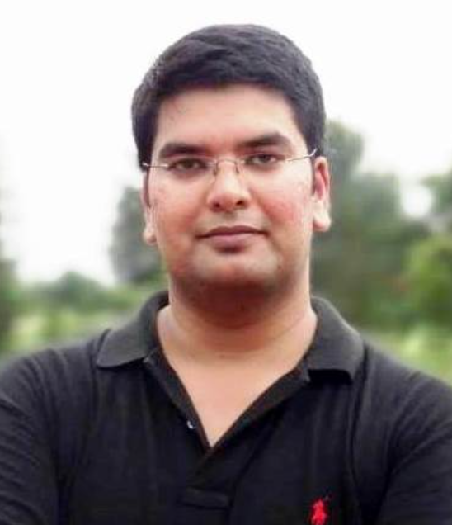

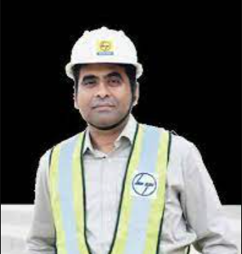
Industry Overview
Competitive Matrix & Brand Leveraging
Strategy for Brand Penetration
Market Trends & Perceptual Mapping
Market Research and Segmentation
Increase in Segment Size
1 2 3
Anjali, 35
Current Roofing Choices
Rahul, 29
Current Roofing Choices
Owns an Architecture firm with 5 other employees
Clay Tiles Concrete RCC
Purchased a new plot of land in a posh society and wants to build a beautiful house.
Clay Tiles Metal Roofs Cemented Ceiling
Reason for current choices
Reason for current choices
Pain Points
Culturally viable
Geographically suited
Ease of access
Pain Points
Peer Influence
Easily available
Geographically Suited
Traditional roofs don’t suit the client demands at times
Very high cost of making concrete ceilings.
Reduces the scope of creating better aesthetics
Water seepage and damp ceiling during rainy season
High cost of maintenance required after every 2-3 years.
High investment required for setting up cemented ceiling.
Harish, 43
Current Roofing Choices
Inder, 48
Current Roofing Choices
Real Estate Builder with contracts across Tier-1 and Tier-2 cities.
Concrete RCC Metal Roofs Slate Tiles, Clay Tiles
Constructor at an Infrastructure MNC responsible for large scale projects
Clay Tiles Metal Roofs
Reason for current choices
Reason for current choices
Pain Points
Future Expansion Prospect
Age old Practices
Solid and strong structures
Pain Points
Readily available
Cost affective
High cost and labor intensive work for concrete RCC roofing.
Metal roofs get corroded very easily leading to frequent damages.
Not very attractive to look at and less scope of better aesthetics.
Clay Tiles unsuitable for the temporary arrangements for the workers.
Clay tiles have a small lifecycle and cannot be reused.
Metal roofs are heavier and unattractive.

Slide 6

Industry Overview
Competitive Matrix & Brand Leveraging
Strategy for Brand Penetration
Market Trends & Perceptual Mapping
Research and Segmentation
Increase in Segment Size
Growth In Housing Sector | Growth
Total Houses in 2016 (Mn) | 248
Total Houses in 2011 (Mn) | 244.6
Average size of a Indian house (Sq m) | 46
Growth in 5 Years (Mn) | 3.4
Multiplication Factor (Growth Projections 2021) | 1.028
Multiplication Factor (Growth Projections 2024) | 1.036
Average Weight of CC Sheet (0.5mm) (kg/sq m) | 10.75
Weight of New Demand Created (Lac mt) | 7.72
Conversion rate % Assumed for CC Sheets | 35
Total Growth for CC Sheets | 2.702
Growth Rate
Growth In CC Demand | In Lac Metric Ton
Rise in Households Demands | 2.70
Rise in Warehousing Capacity | 1.57
Total Growth | 4.28
% Growth for CC Sheets Market | 20.56

Slide 7

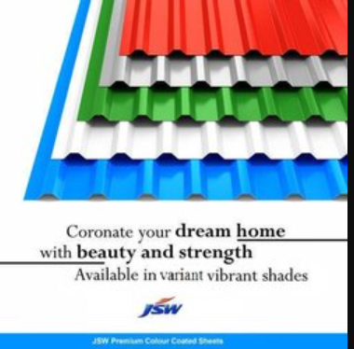








Industry Overview
Competitive Matrix & Brand Leveraging
Strategy for Brand Penetration
Market Trends & Perceptual Mapping
Research and Segmentation
Increase in Segment Size
Brand Leverage
Competitor Matrix
JSW CC Sheets
JSW Competitors
Benefits
Aesthetics
Superior Technology
Thermal Efficiency
Easy Maintenance
Longer Life
Durability
Better Value
Anti- Corrosion
TATA BlueScope
Everest Industries
Weather Protection
Bansal Roofing
Hindalco Ind Ltd.
Better Aesthetics
Strength
The Will Of Steel
Longer Life
JSW is the Largest Color Coated Steel Producer in India.
JSW is India’s first licensed GalvalumeProducer.
JSW has the largest integrated special alloy steel plant in India.
JSW is India’s first ISI certified coloured-coated sheets.
Reframe 'Steel': Steel (noun) to Steel (verb) . Steel (n): Metal, cold, emotionless, strength as a specification
Steel (v): Emotional, inspirational, a belief system that gives strength to endure and persevere
Creative articulation
JSW Steel = Strength within: The Will Of Steel
Superior Technology
Durability
Superior Paint Technology
Re-Branding and Positioning
Thermal Efficiency
Better Value
Easy Maintenance
Stringent Quality Tests
"Where others see walls, I see doors" – O.P Jindal

Slide 8
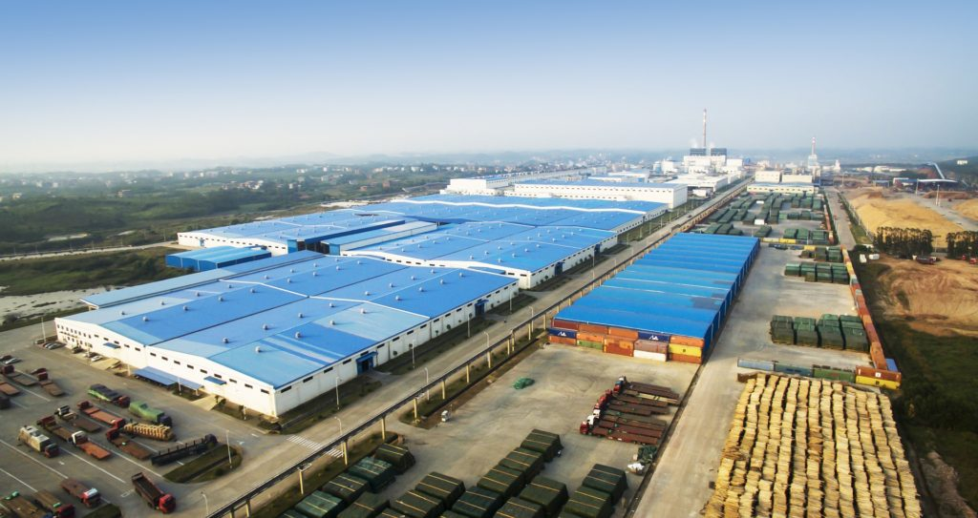
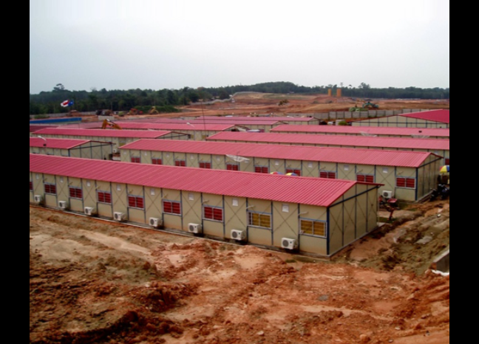
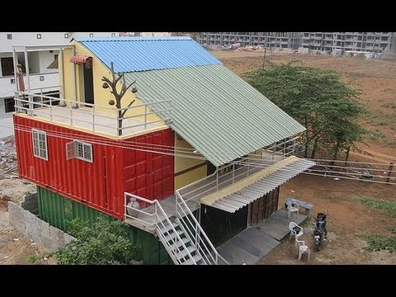
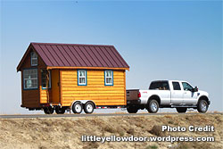
Industry Overview
Competitive Matrix & Brand Leveraging
Strategy for Brand Penetration
Market Trends & Perceptual Mapping
Research and Segmentation
Increase in Segment Size
Mobile Van on Display
(for semiurban and rural sector)
1 2 3
Category Penetration
Mobile Van on Display with a House-Shaped Structure with JSW CC Sheets at the roof-top
This helps for instantaneous activation and visual touch points
Consumers will be able to realise the use of CC Sheets because of the Visual Appeal
JSW CC JSW CC
JSW CC JSW CC
JSW CC JSW CC
JSW CC JSW CC
JSW CC JSW CC
JSW CC JSW CC
JSW CC JSW CC
JSW CC JSW CC
JSW CC JSW CC
JSW CC JSW CC
JSW CC JSW CC JSW CC JSW CC JSW CC
JSW CC JSW CC JSW CC JSW CC JSW CC
JSW CC JSW CC JSW CC JSW CC JSW CC
JSW CC JSW CC JSW CC JSW CC JSW CC
JSW CC JSW CC JSW CC JSW CC JSW CC JSW CC
JSW CC JSW CC
JSW CC JSW CC
Sustainable Practice
Aesthetically Pleasing
No Water Logging
No Water Leakage & Seepage
End Consumers will be able to physically check and enquire about the answer to pain point of leakage which is faced frequently in traditional roofing systems like clay tiles and asbestos sheets
Colour does not wash or fade way with time due to seepage and hence has a longer life
Market Acquisition & Consumer engagement towards contribution in Sustainable Construction Practices
Use of RCC and Clay tile roofing needs Cement in huge quantities which results in the huge CO2 production while use of CC sheets will be a Sustainable practice
Visual Appeal
Effective in disaster prone regions and places with heavy rainfall as inclined roofing's will prevent water logging and hence re-work and damping’s
Easy for Maintenance as it is all weather effective and requires low investment for implementation
Variety of Colours adds to the aesthetics to the newly built houses and give them a visual appeal
Consumers will be able to form an imagination and have the realization of how their abode will look like
Rise in Demand for temporary houses and tents where tourism is prevalent because of aesthete

Slide 9
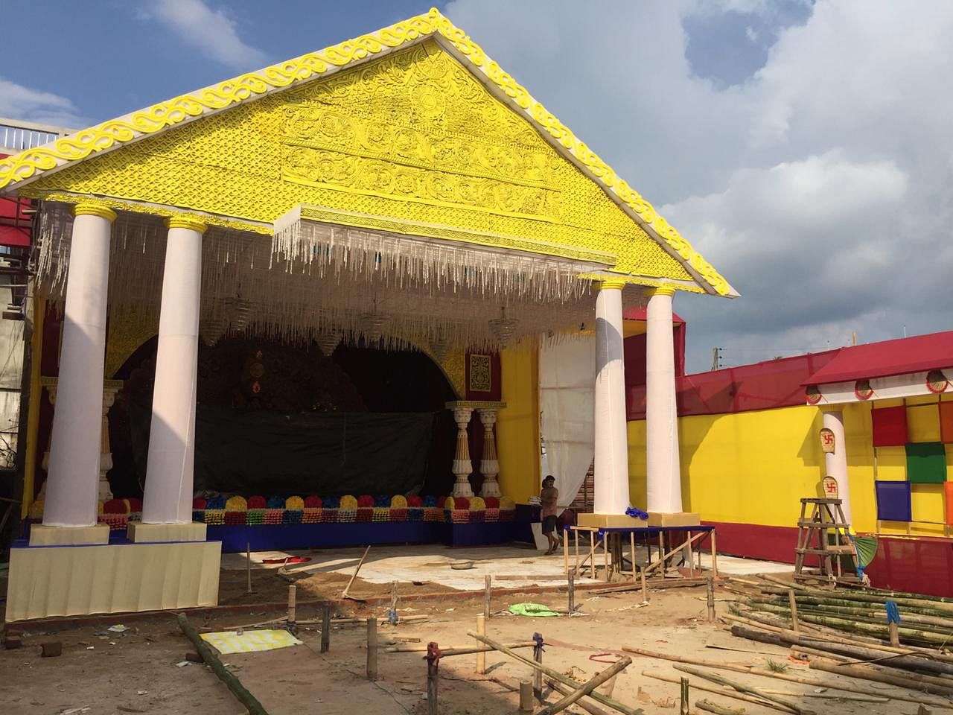
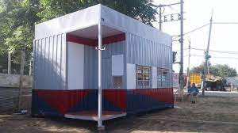
Industry Overview
Competitive Matrix & Brand Leveraging
Strategy for Brand Penetration
Market Trends & Perceptual Mapping
Research and Segmentation
Increase in Segment Size
1 2 3
Temporary Structures
(institutional and cultural set-ups)
Category Penetration
Canopy and Temporary structures building like Mobile Police Booth, Traffic Booths, Pandals for festivals
Colourful JSW CC Sheets all over for Greater Visibility
Boost in the usage of sheets in Commercial Sector
JSW CC JSW CC
JSW CC JSW CC
JSW CC JSW CC
JSW CC JSW CC
JSW CC JSW CC
JSW CC JSW CC
JSW CC JSW CC
JSW CC JSW CC
JSW CC JSW CC
JSW CC JSW CC
JSW CC
JSW CC
JSW CC
JSW CC
JSW CC JSW CC JSW CC JSW CC JSW CC
JSW CC JSW CC JSW CC JSW CC JSW CC
JSW CC JSW CC JSW CC JSW CC JSW CC
JSW CC JSW CC JSW CC JSW CC JSW CC
JSW CC JSW CC JSW CC JSW CC JSW CC JSW CC
Emotional Quotient
Cultural Acceptance
Vast Coverage & Network
Will of Steel
(WOS)
Usage in Traffic Booths and Mobile Police Booths for people to believe in the brand
Leveraging the will and strength of policemen and coagulating it with the Will of Steel (WOS) of JSW
Venture in large contracts with state governments gripping the indomitable spirit of the police
Collaboration with states and for pandals and setups during festivals like Durga Puja in West Bengal, Ganesh Utsav in Maharashtra
Associate the brand with the emotional value and influence the influencers who spread the word of mouth
Greater Visibility
Booths present at each Chouraha & Nukkad, hence provides the required touch points & visibility
Reaching out to the people who mattered; protecting those who protect us
The brand has to be felt; one should feel the steel in their nerves
Coloured sheets will fulfil the cultural aspirations of the regions who are relating themselves with particular colours
Collaborations during festivals will impact the normal consumers as well resulting in increment of sales from dual consumers because of aesthetic appeal

Slide 10
Industry Overview
Competitive Matrix & Brand Leveraging
Strategy for Brand Penetration
Market Trends & Perceptual Mapping
Research and Segmentation
Increase in Segment Size
1 2 3
Large Commercial Establishments
Brand Penetration
Targeting Multi-crore projects by larger manufacturing and construction firms for their Labour Camps and temporary establishments.
Thrive in the Infrastructure sector leading to increasing disposable rural population at project sites.
Boost in the usage of sheets in Commercial Sector for industrial purposes
JSW CC JSW CC JSW CC JSW CC JSW CC
JSW CC JSW CC JSW CC JSW CC JSW CC
JSW CC JSW CC JSW CC JSW CC JSW CC
JSW CC JSW CC JSW CC JSW CC JSW CC
JSW CC JSW CC JSW CC JSW CC JSW CC JSW CC
Diversifying portfolio of JSW
Tie-Ups
Vast Coverage & Network
Better Living Standards
Improved Quality of life for Workers and Blue-Collar Staff working at the Project Site
Risk-free stay during the entire course of projects
Improved productivity because of the improved happiness quotient of the workers
Collaboration with Governments of flood prone states for helping them with temporary setups in times of need as part of their CSR activity
This will strengthen the confidence in general consumers about the goodwill of the brand and hence increasing its value and market share
Major Benefactor
Booming infrastructure sector across the country contributing to the increment in disposable population
Tie-ups with conglomerates namely L&T, Reliance, TATA etc. working in this sector
Tie-ups with E-Commerce and FMCG giants helping in the expansion of their warehousing capacities
Incentives for bulk purchases as warehousing grows at an annual rate of around 9% over the next 5 years
Growing no. of factories, poultry farms, and development of SEZs

Slide 11
Thank You!

